Slide 1
Skew Heaps

Slide 2
Binary Heap Priority Queue Data Structure
Heap-order property (Min Tree)
parent’s key is less than children’s keys
result: minimum is always at the top
Structure property
almost complete tree with leaf nodes packed to the left
result: depth is always O(log n); next open location always known
2
4
5
7
6
10
8
11
9
12
14
20
How do we find the minimum?
Notes:
Alright, there are two problems with binary search trees as pqs.
First, they’re overkill. Why keep everything ordered? We just need to know the least at any given time.
Second, they’re not guaranteed to be complete, so we have worst case O(n) times.

Slide 3
Clever Storage Trick allows us to easily find parents/kids without pointers
Calculations:
child:
parent:
root:
next free:
0
2
1
2
4
5
3
4
5
6
7
6
10
8
11
9
12
14
20
7
8
9
10
11
0
1
2
3
4
5
6
7
8
9
10
11
12
2
4
5
7
6
10
8
11
9
12
14
20
Notes:
It so happens that we can store a complete tree in an array and still be able to find children and parents easily. We’ll take advantage of this.
Child:
left = 2*node
right = 2*node + 1
parent = floor(node/2)
root = 1
nextfree = length + 1

Slide 4
DeleteMin
pqueue.deleteMin()
2
2
20
4
5
4
5
7
6
10
8
7
6
10
8
11
9
12
14
20
11
9
12
14
20
Notes:
OK, to delete, we start by plucking out that value in O(1) time.
Now, we have a hole at the top, and a node that isn’t proper for a complete tree at the bottom.
So, we fix it by putting the value in the hole, and moving the hole until we restore the heap-order property.

Slide 5
Percolate Down
20
4
4
5
20
5
7
6
10
8
7
6
10
8
11
9
12
14
11
9
12
14
4
4
6
5
6
5
7
20
10
8
7
12
10
8
11
9
12
14
11
9
20
14

Slide 6
Insert – put node where the next node goes – to force shape.
pqueue.insert(3)
2
2
4
5
4
5
7
6
10
8
7
6
10
8
11
9
12
14
20
11
9
12
14
20
3
Notes:
Inserting works similarly. We tack a hole on at the end of the tree, and move that hole _up_ until it’s in the right place for the new value.

Slide 7
Percolate Up
2
2
4
5
4
5
7
6
10
8
7
6
3
8
11
9
12
14
20
3
11
9
12
14
20
10
2
4
3
7
6
5
8
11
9
12
14
20
10

Slide 8
Performance of Binary Heap
 | Binary heap worst case
Insert | O(log n)
Delete Min | O(log n)

Slide 9
Merging?
Different scholarship PQs which need to merge after certain deadlines.
This would not be efficient with an AVL tree or a heap (stored as an array). We need a new idea.

Slide 10
New Operation: Merge
Merge(H1,H2): Merge two heaps H1 and H2 of size O(N).
E.g. Combine queues from two different sources
Can do O(N) Insert operations: O(N log N) time
Better: Copy H2 at the end of H1 (assuming array implementation) and use Floyd’s Method for BuildHeap.
Running Time: O(N)
Can we do even better with a different data structure? (i.e. Merge in O(log N) time?)

Slide 11
Skew Heap
A skew heap (or self – adjusting heap) is a heap data structure implemented as a binary tree.
Skew heaps are advantageous because of their ability to merge more quickly than binary heaps. In contrast with binary heaps, there are no structural constraints, so there is no guarantee that the height of the tree is logarithmic.
Only two conditions must be satisfied :
The general heap order must be there (root is minimum and same is recursively true for subtrees), but balanced property (all levels must be full except the last) is not required.
Main operation in Skew Heaps is Merge. We can implement other operations like insert, extractMin(), etc using Merge only.

Slide 12
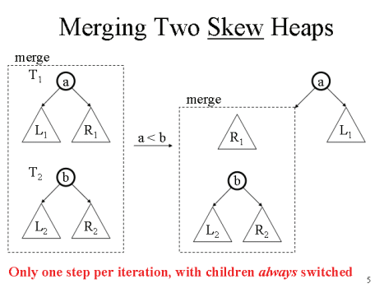
Merging Skew Heap

Slide 13
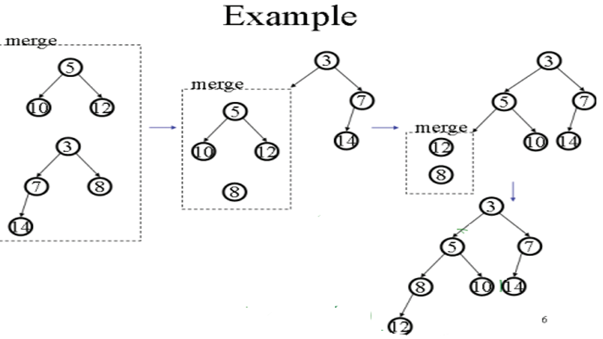
Skew Merge Example

Slide 14
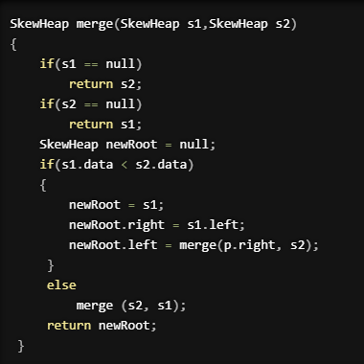
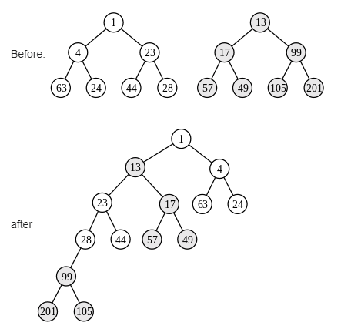
Skew Merge

Slide 15
Let’s consider this operation from a recursive point of view. Let L be the tree with the smaller root and R be the other tree.
If one tree is empty, the other is the merged result.
If t is the tree with the smaller value, Let t->right = merge (t->right, other)
Swap the kids of t
The result of child swapping is that the length of the right path will not be unduly large all the time.
The amortized time needed to merge two skew heaps is O(log n).

Slide 16
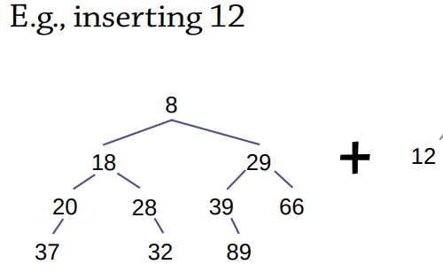
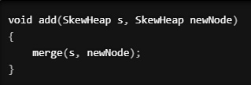
Insertion using Skew Merge

Slide 17
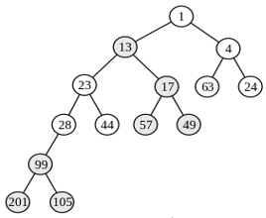
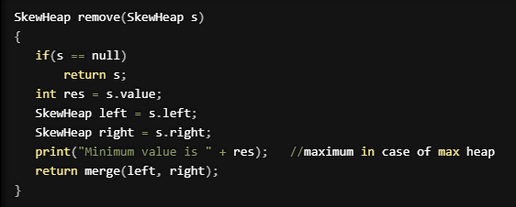
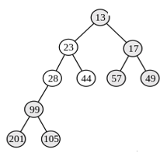

Delete min in skew heap
+

Slide 18
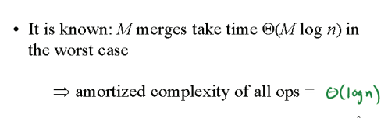
Time complexity of Skew Heaps

Slide 19
References
https://www.geeksforgeeks.org/skew-heap/
https://en.wikipedia.org/wiki/Skew_heap#:~:text=Skew%20heaps%20are%20advantageous%20because,heap%20order%20must%20be%20enforced
https://iq.opengenus.org/skew-heap/
https://courses.cs.washington.edu/courses/cse326/08sp/lectures/markup/06-skew-heaps-markup.pdf

